Slide 1
New features in Angular v15
Angular v15 brings many improvements and new features. This section only contains some of the innovations in v15.
Angular v15 is now available!. Over the past year we removed Angular’s… | by Minko Gechev | Angular Blog
What's new in Angular 15? (youtube.com)

Slide 2
Angular v15
Improved Stack Traces for Debugging
Improvements in the Language Service
Blazingly Fast Builds with ESBuild
Image Optimizations
Less Config Files by Default
Functional Route Guards
Tree Shaking the CommonModule
Functional APIs for Router and HTTPClient
Functional HTTPClient
Directive Composition API
Stable Standalone Components
Generating Standalone Components

Slide 3
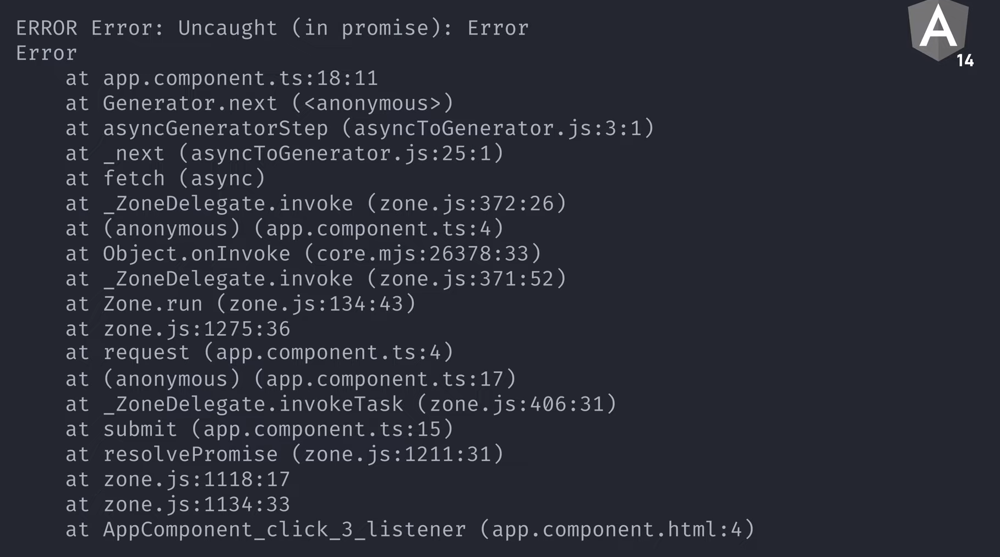
Improved Stack Traces for Debugging

Slide 4
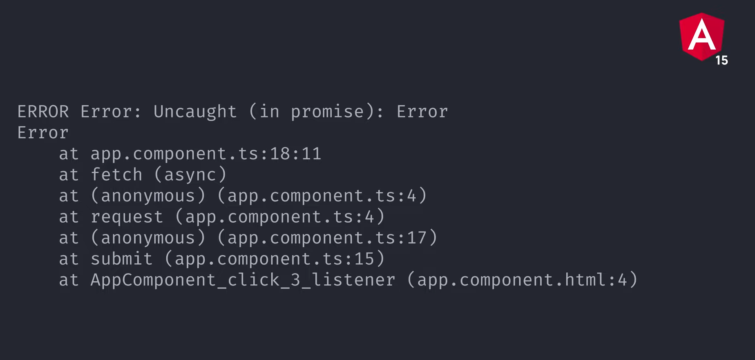
Improved Stack Traces for Debugging

Slide 5
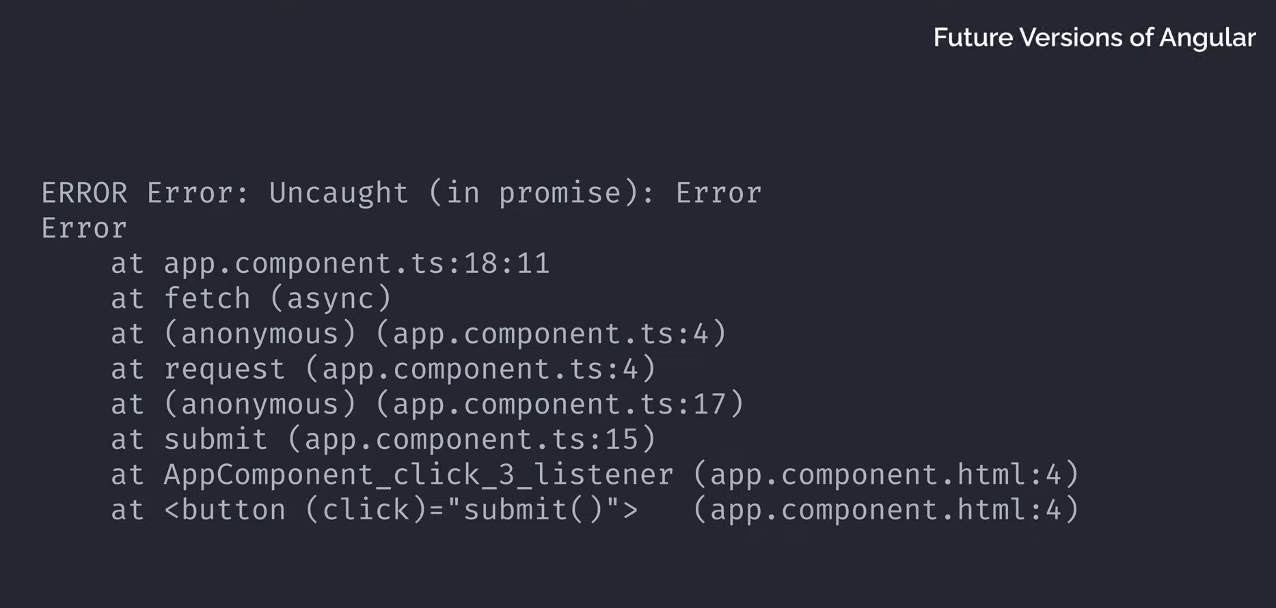
Improved Stack Traces for Debugging

Slide 6
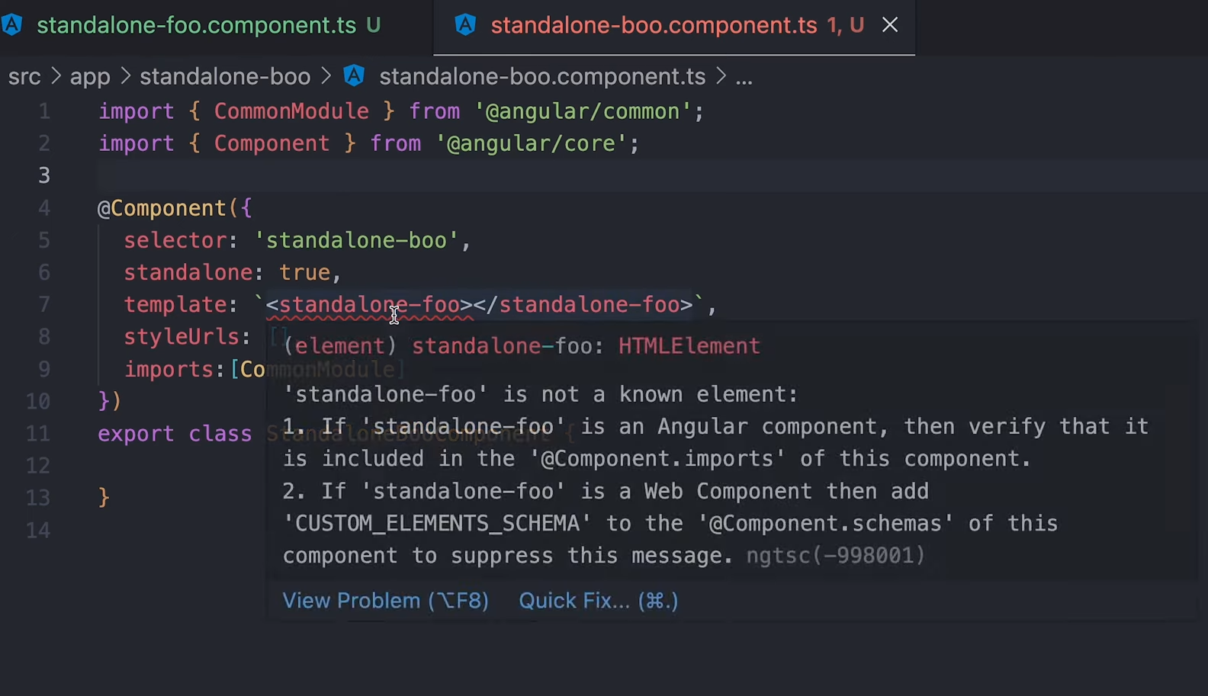
Improvements in the Language Service
Will auto import both ngModule and standalone component

Slide 7
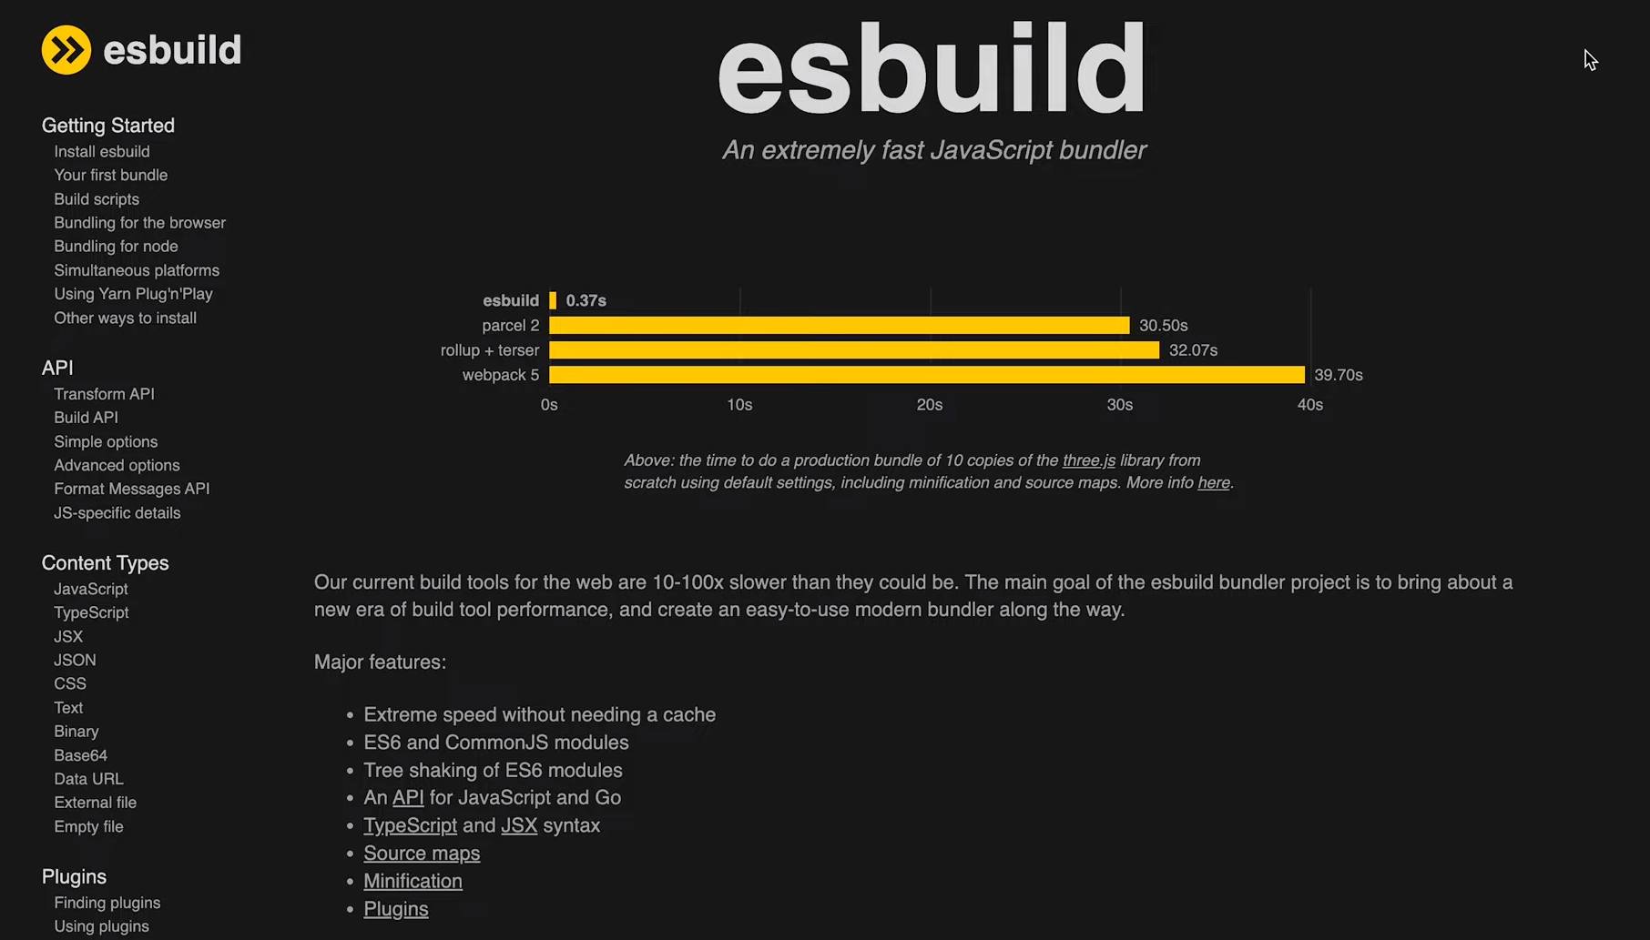
Blazingly Fast Builds with ESBuild
"builder": "@angular-devkit/build-angular:browser“
Swich to
"builder": "@angular-devkit/build-angular:browser-esbuild"

Slide 8
NgOptimizedImage Directive
Lazy load images
Preload nesssary images
Download correct resolutions
Download correct formats

Slide 9
CLI improvements Less Config Files by Default
In the Angular CLI we introduced support for standalone stable APIs. Now you can generate a new standalone component via ng g component --standalone.
We’re also on a mission to simplify the output of ng new. As a first step we reduce the configuration by removing test.ts, polyfills.ts, and environments. You can now specify your polyfills directly in angular.json in the polyfills section:
"polyfills": [
"zone.js"
]

Slide 10
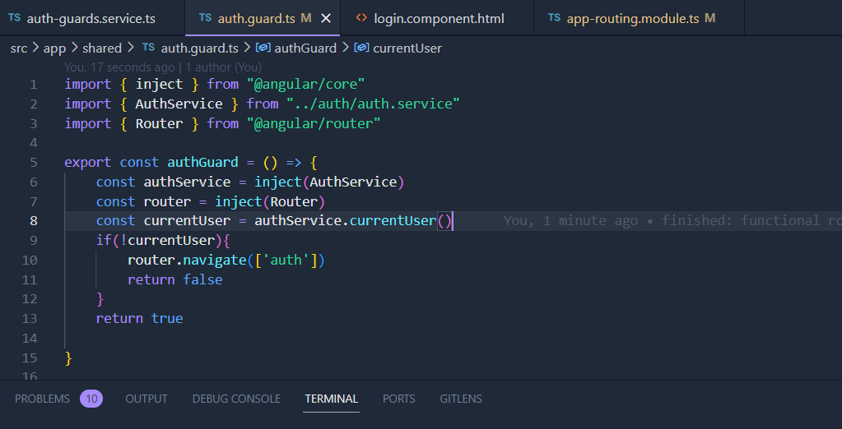
Functional Route Guards
This is really a revolution! Trust me, you will love it and I think this may make component-based Guards disappear in the future. It’s quick, and simple with less boilerplate:

Slide 11
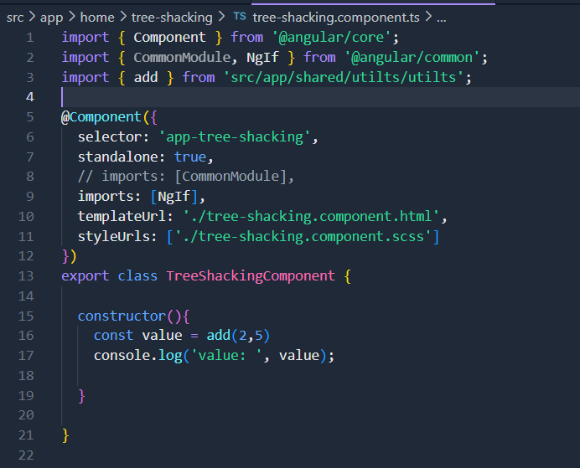
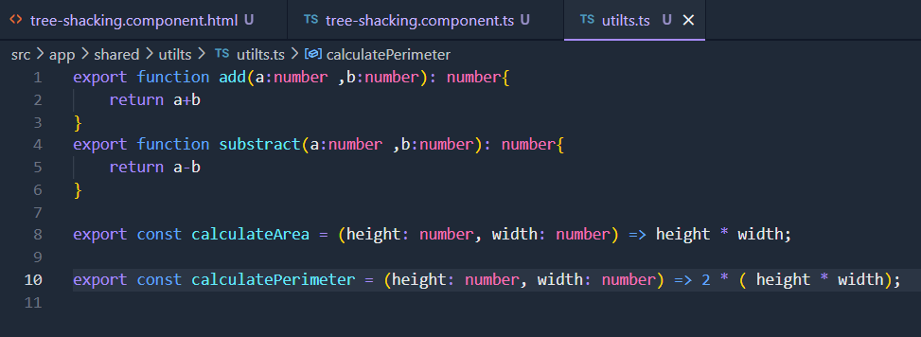
Tree Shaking the CommonModule
The process of removing dead (unused) code from the application bundle

Slide 12
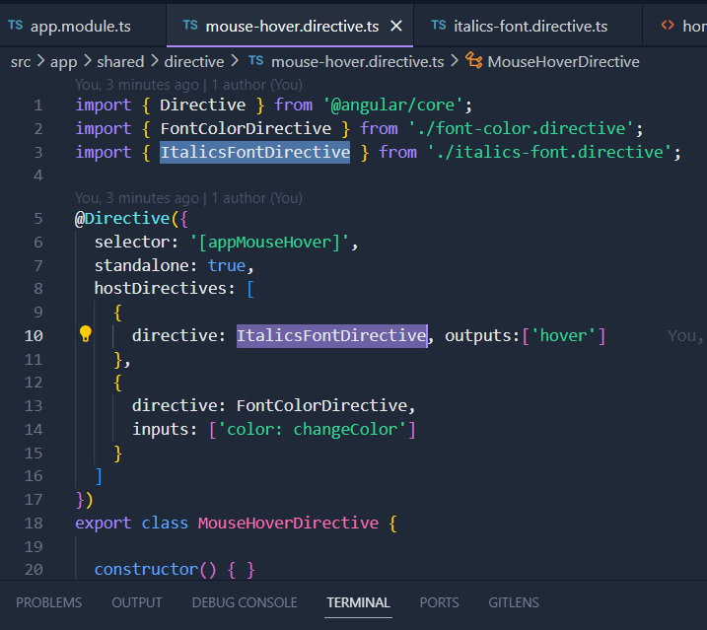
Directive Composition API
The directive composition API brings code reuse to another level! This feature was inspired by the most popular feature request on GitHub asking for the functionality to add directives to a host element.
The directive composition API enables developers to enhance host elements with directives and equips Angular with a powerful code reuse strategy, that’s only possible thanks to our compiler. The directive composition API only works with standalone directives.

Slide 13
Stable Standalone Components
The standalone components API lets you build Angular applications without the need to use NgModules

Slide 14
Generating Standalone Components

